Slide 1
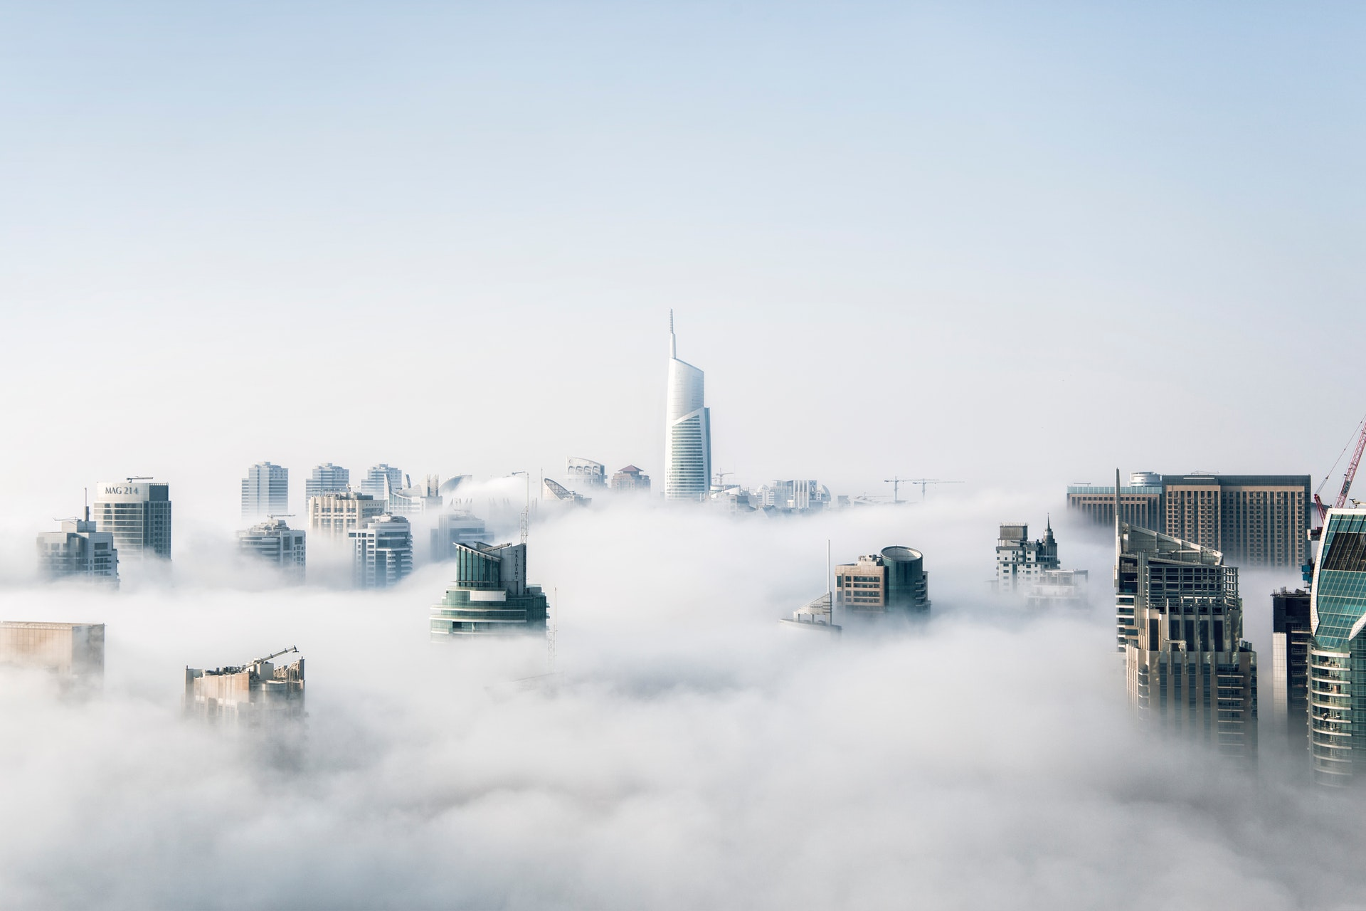
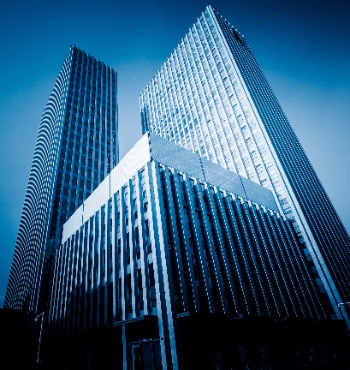



2020 PwC 24-Hour Business Challenge
Australian
Retail Industry
Analysis
Double Caiji from Dong Hua University
Directory
Foreword
Circumstance Analysis
Strategy

Slide 2
Foreword
1
Background introduction
2
Executive summary
Due to the development of technology, online shopping is a major concern for traditional shopping models as well as shopping centers because of commodities with the ease of purchasing, larger ranges and lower prices. The development
of the e-commerce does not have a devastating effect on the Australian native retailers and it also has the opportunity to change their traditional pattern and meet the needs of consumers.
Therefore, measures should be taken in order to help traditional shopping models make more profits and to exist. Considering the features of traditional shopping models and the situation of macroeconomics in Australian, suggestion on the strategy has been given from the customers, commodities and other related aspects. From what has been mentioned above, we hope that the traditional shopping models can make full use of this opportunity to turn the crisis into opportunities and complete the self-transformation and upgrading.
Retail industry needs to use technology to expand online business
Offline shopping center need to be transformed
Macroeconomics
S
W
Analyze
E-commerce
The impact of
O
T
International trade
Consumer preferences
……
Strategy about external, internal management & structure upgrading
Combine the network for promotion and sales
Speed ​​up the brand upgrade
Guarantee the operation of the shopping center enterprise
Promote the transformation of the shopping center
Surrounding commercial
2

Slide 3

1
Circumstance Analysis
Strengths
Higher sense of experience
The overflow effect
Weaknesses
Higher operation overheads
Outdated technology
Slow speed of upgrading
Passive consumption models
Opportunities
The traditional retail industry is still dominating
Circular economy is the new ticket to play
The cash flow is the king
Threats
Higher e-commerce expectations
Booming e-commerce
Macroeconomic recession
The development of overseas trade

Slide 4
Higher experience and driving the overflow effect.
1
Sense of experience
2
Shopping safety
In-store shopping allows customers to experience products face-to-face. Compared with online shopping that only looks at pictures or 3D virtual technology, consumers can feel the goods through touching, tasting, smelling and seeing, so that consumers can be more satisfied with the products they buy, and there will be rarely returns, which can also increase shopping satisfaction.
Online shopping may be cheated due to the dishonesty and fraud of merchants, which makes the goods you buy not is the real thing you want. So the online shopping will reduce the safety of shopping, but offline shopping can better guarantee shopping safety, consumers are less easier to be cheated in the traditional shopping models.
Touch
Taste
Smell
See
Online
Commodity
Not I want
Offline
It’s what I want!
3
Customers satisfaction
4
The overflow effect
Shopping online just communicate with words, but salespeople in the store can recommend products to customers. Offline stores will also have professionals to provide customers with advice on purchasing items. Through the face-to-face communication, it can give customers a more intuitive impression, increase the customer's shopping experience, and thus improve the sales success rate.
Shopping
center
Regional economic development
A successful offline retail industry will attract customers to consume in the store, and due to the increase in the flow of customers, which will promote the development of the surrounding store economy and the regional commercial, so a butterfly effect may occur, making the entire economic belt prosperous. Most of this situation occurs in shopping malls and shopping circles.
Online
Face to Screen
Surrounding commercial
In-store
Face to Face
4

Slide 5
Compared with e-commerce, the development of the traditional retail industry can’t keep up with the information era, thus causing many drawbacks.
1
The high operation overheads increase the in-store industry costs
2
Outdated technology makes stores less profitable
The expectation of leasing items
Suppliers and consumers carry out transactions directly
Weekly Rental costs($)
Use e-commerce
Significant
changes
NOW
Manufacturer
Buyer
Manufacturer
Buyer
Remain
the same
NOW
NO GOODS
Slight
changes
PAST
PAST
PAST
Store warehouse
Store
Overstock
The suppliers directly trade with the customers resulting in the stock remaining in the store warehouse, which is now shipped directly back to the supplier.
It prevents retailers from playing a significant role, and it will cause that the store does not have enough products to provide customers and reducing the customer shopping experience，which can also reduce the store customer flow and profits.
The rental overheads are increasing and retailers are reluctant to change the rental items frequently.
PLUS
The outdated technology makes the product replacement slow, which is unable to meet the needs of customers, reducing the desire of customers to shop, thereby losing customers.
……
PLUS
Salaries of employees
Transportation costs
Inventory cost
Source: KPMG Survey ; Australian Bureau of Statistics
5

Slide 6
Compared with e-commerce, the development of the traditional retail industry can’t keep up with the information age, thus causing many drawbacks.
3
The speed of upgrading in commodities is very slow
4
Consumers need to take the initiative to find products
In-store
Online
shopping
Result in
A new store
come
A old store
remove
Consumers cannot predict the goods sold in the store, so
they need to actively look for the goods, which greatly increases the cost of time, thereby reducing consumer satisfaction.
The website can record the consumer's preference behavior, which can recommend products to consumers better and reduce the time cost.
Need
The speed of upgrading in commodities is very slow and high cost
Result in
Spend a lot of money and time
Commodities
Considering its space, shops in a traditional shopping center alternate slowly. When a shop in an out-dated trend have to leave, a shop in a new trend will have the chance to enter. In terms of the commercial opportunity, it is such a long term to remove the old shop and renovate a new store. It also needs a lot of money and time, which means the losses of profits. On the contrary, new business trends can quickly appear on e-commerce platforms because there is no space restriction.
Compared with traditional models, consumers’ data and consumption preferences will be memorized as long as they browse. Through big data technology, the application will recommend the commodities consumers care about, which can easily stimulate the desire to buy. In traditional models, consumers can’t predict what is being sold in the store. They have no purpose in shopping and only buy the product they like. Consumers need to take the initiative to find products. The idiomatic large-scaled sales promotion will just lead to consumers’ disgust and eventually to the loss of consumers.
6

Slide 7
Even though e-commerce is priming to boom, it does not have the ability to completely replace in-store industry right now.
1
E-commerce is the future, but it is not
dominating now
2
The customers want to take it slowly
The expectation of the
number of the stores
E-commerce revenue change
Consumption conditions
Do not operate
Change
Revenue from e-commerce
Stay the
same
Decrease
Insights
The online shopping market is expanding, but the retail market still dominates now. Profits mainly come from the in-store industry.
Customers and the retailers want traditional retail industry to change step by step, which means the retail market will not disappear so quickly.
Source：InsideRetail ; KPMG Survey
7

Slide 8
New era and new trends have also brought opportunities for transformation and goals of the retail industry.
1
Circular economy is the new ticket to play
2
The impact of new payment platforms on retail industry shows no signs of slowing down
In response to a global environmental disaster, a cycle economy is the new ticket to play in retail. The circular economy gives new life to products and materials that would otherwise make their way to landfill, letting products have an infinite lifecycle through different uses. Globally, governments and industries are developing initiatives to promote the circular economy.
Debit cards are Australian favorite payment method accounting for ~50% of all payments. The development of debit cards has resulted in two key outcomes : Faster checkout and Least cost routing.
The development of Cards
The development of credit cards and the emergence of mobile payment also allow consumers to enjoy buying now paying later, which greatly enhances consumers’ desire to buy things.
NEWS:
Invest
In order to
connect buyers with sellers in the circular economy
$167 million
Planet Ark
a Circular Economy Hub
Extract
Use
Through repair and sharing, reusing can be realized.
Insights:
Recycle
Recover & Mange
Sustainable economy and the development of buying now paying later (BNPL) are both new trends. Seizing it and grasping the new needs of the consumers are the opportunities for the development of the retail industry. In addition, there are many similar needs, such as Social customer care, brand effect ……
Produce
Infinite
cycle
loop
The residential waste generated by this process allows resources to be extracted by energy recovering.
Resources can also be produced through remanufactured and redistribution
Recover
& Mange
Use
Source：Victorian Government；KPMG Australian ; Reserve Bank of Australia
8

Slide 9
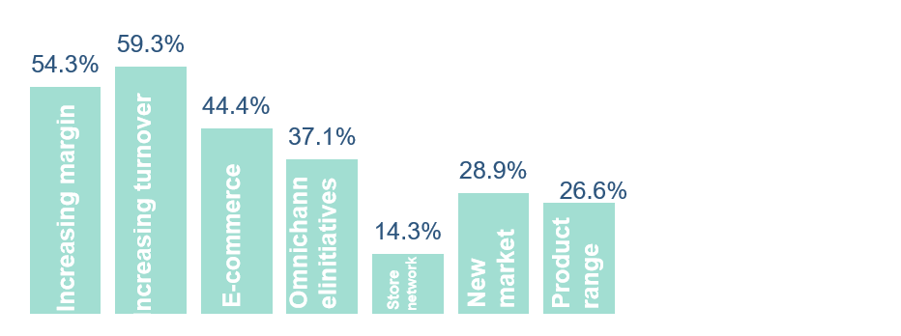
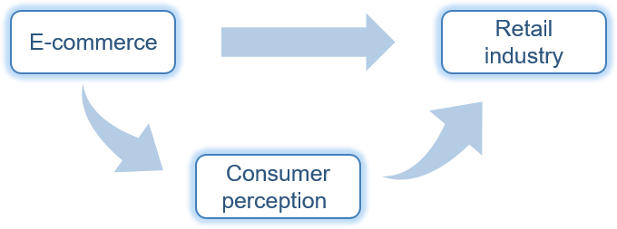
Changes in consumer perception and the development of e-commerce impact the Australian traditional retail industry.
1
Public’s expectations for e-commerce have increased in recent years
2
The e-commerce is priming to boom
E-commerce growth in Australia
Consumer’ expectations
2005
2010
2015
2018
Retailer’ expectations
Insights
Whether consumers or retailers, they have very high expectations for the development of e-commerce. Consumers pay more attention to the development of the logistics industry and suppliers seek a multi-channel sales environment.
The growth rate of online retail has become an important part of the growth of the retail industry. In the meantime, it changes the consumers' perceptions and indirectly compacts the development of the retail industry.
Source：InsideRetail ; KPMG Survey
9

Slide 10
Changes in the macroeconomic situation and the development of trade globalization have impacted the local traditional retail industry.
1
The economic growth is slow, and the bank interest rates continue to fall
2
The development of international trade has occupied the local retail market
CPI
GDP
2010
2015
2020
GDP is declining year by year, and the CPI has the same trend, which means that Australia‘s economy is not very unsatisfactory. The government can only maintain interest levels by reducing interest rates. It is precisely because the macroeconomic is not so good that it may reduce the consumer's ability and desire to consume, making the retail industry facing a depression.
Views on the influx of international retailers
More concerned than last year
Less concerned
Not concerned
Impact of the influx of international retailers
Positive impact
Negative impact
No impact
The globalization of trade has led to the influx of many companies and increased the competitive pressure of the local retail industry. It poses a threat to the development and operation of the local retail industry.
Source：Australian Bureau of Statistics
10

Slide 11
2
Strategy
External management
Internal management
Structure upgrading

Slide 12
Strategy Overview
The Strategy From Shopping Center Aspect：
Retailer’ issues
Diversification
Offshore online retailer
External
Use social media to promote products
Discounting
Marketing method: Seasonal discounts
Consumer confidence
Labor costs
Employee training
Rental overheads
ERP Inventory management
Global economic factors
Internal
Adaption to regional economic development
Australian dollar
International entrants
Other
Brand diversification
Structure
Pop-up stores
From the above survey and the circumstance we analyzed before. The issues that the retailer needs to solve are:
Reinvention
GOAL
How to integrate into the growing international trade?
How to maintain sales when the macroeconomic recession?
How to increase customers' consumer confidence?
How to reduce the operating costs of the retail industry?
How to choose the marketing method?
External
Internal
Structure
Surrounding commercial
Attract consumers
Keep consumers
transformation
Increase profits
Keep long-term development
12

Slide 13
Three ways to improve the quality of store sales.
1
The diversification of products and brands
3
Multi-channel branding
Shopping center
Shopping
amusement
catering
Service
Various business should be introduced into the shopping center, especially new forms of business. Besides shopping, businesses focusing on the sense of experience such as cinemas, canteens and other services’ providers are supposed to put more emphasize on, which can give customers “One-Stop Shopping” services.
The picture on the left is the most effective social media channels for retail business in Australia. With the development of e-commerce, the offline store needs to expand sales channels to
Facebook
Instagram
Linkedln
Blog/Web
Don’t use social media
Result in
Other channels
Result in
Competition
Profits
online shopping. Opening an official account of a social media will let
nearby consumers know your store through the GPS. If the goods are attractive enough, then customers will make offline purchases. With the expansion of the brand, you can also have your own APP, or join some online shopping platforms.
SHOP
Cinema
Gym
……
Result in
Result in
Result in
Different kinds
Shops
Consumer
Appear
Sales have the same trend every year, we have to discount in the peak sales season, and increase prices in the off-season.
2
Seasonal discounts
Market
test
……
Price
in December
Social media
Online shopping
platform
Various apps
Price
in January and February
Source：Australian Bureau of Statistics ; KPMG Survey
13

Slide 14
Three methods of internal management.
1
Happy employees = Happy customers
Adaption to the level of regional economic development
2
Six Pillars of Customer
Experience Excellence
Personality is the most important driver for customers’ satisfaction and loyalty. As the owner of a retailer, employees need to be trained based on the six pillars of customers experience excellence enhancing their work enthusiasm to improve customer satisfaction and loyalty.
The customers’ demands and habits depend on the level of economy. Therefore, a proper business orientation as well as an accurate assessment of the customers’ demands will help the shopping center make more profits. In the CBD of the city, the sale of luxury goods and demands of white-collar workers should be shed light on. Neighborhood centers are supposed to put more emphasize on daily demands of nearby residents, especially local agricultural and fishery products which have comparative advantages in terms of international trade. Finally, sub-city centers will play the role of balance and transition.
Sub-city center
CBD
Neighborhood center
2
ERP system
Inventory management can improve the speed of product upgrading and ensure the quantity of inventory.
Supplier
Produce
Design
Purchase
Produce arrangement
Order
management
Raw material
Mold
Workshop management
Logistics
Marketing
Material storehouse
Workshop
Sales
Source：InsideRetail
14

Slide 15
Make reasonable use of shopping center space resources, and configure the center's store selection.
1
Pop-up stores: The Future of Retail
2
Reinvent the shopping center
The emergence of pop-up shops has solved the high cost and long-term decoration of brands, and has increased the speed of brand renewal in shopping centers. Considering the costs and the comprehensiveness of types, the emergence of the pop-up shops in various industries will optimize the number of stores and the configuration of brands.
Many retailers and the estate developers in Australia have begun to reinvent the concept of shopping centers, integrate different types of real estate, and achieve higher occupancy rates and rents. So shopping centers should slowly increase residential or office space.
Pop-up store type | Labor costs | Scene cost | Plan cost | Site cost | Other costs
Sales
Brand Promotion
Central issue
Market test
Low passenger flow
Industry | Experiential marketing | Show rooming | New brand | Sales effect
Cosmetic
Clothing
Snacks
3C/APP
Conclusion：
Result in
E-commerce
Low profits
Sales
Brand
Promotion
Central
issue
Market
test
So
Build
Cosmetic
Clothing
Snacks
3C/APP
Office building
Residential area
Remove
the retail store
Source：Sina
15

